Slide 1
Design Patterns
Adapter Pattern

Slide 2
Adaptor Pattern
According to the Gang of Four, the intent of the Adapter pattern is to:
  Convert the interface of a class into another interface that the clients expect. Adapter lets classes work together that could not otherwise because of incompatible interfaces.
Intent: create a new interface

Slide 3
Example
Create classes for points, lines, and squares that have the behavior "display."
The client objects should not have to know whether they actually have a point, a line, or a square. They just want to know that they have one of these shapes.
free the client object from knowing details

Slide 4
Another Situation …
You have wanted to use a subroutine or a method that some one else has written because it performs some function that you need.
You cannot incorporate the routine directly into your program.
The interface or the way of calling the code is not exactly equivalent to the way that its related objects need to use it.

Slide 5
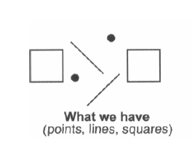
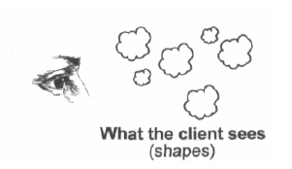
Coming back to our shapes example …
We want the client objects to think we have only shapes.
  allows the client objects to deal with all these objects in the same way.
  enables to add different kinds of shapes in the future without having to change the clients

Slide 6
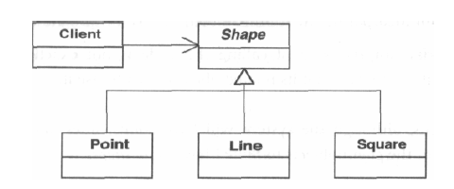
How to do this …
Use derived classes polymorphically
  define the interface and then implement in derived classes
Specify behaviour of the Shapes
  Set a shape's location.
  Get a Shape's location.
  Display a Shape.
  Fill a Shape.
  Set the color of a Shape.
  Undisplay a Shape

Slide 7
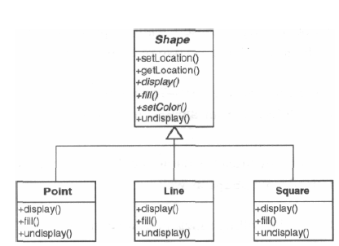
What if you want to add a new shape Circle?
Write a new derived class and write all relevant methods

Slide 8
What if I have a relevant class?
Somebody wrote easyCircles with the following methods:
  displayIt
  fillIt
  undisplayIt
Cannot use easyCircles directly
  Different names and parameter list
  Cannot derive it
Adapt it

Slide 9
How to implement
Derive a new class Circle from Shapes
Circle contains easyCircles.
Circle passes requests made to the Circle object on through to the easyCircles object.

Slide 10
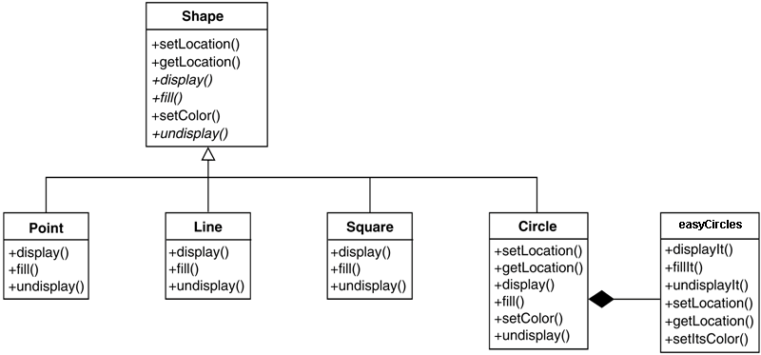

Slide 11
class Circle extends Shape {
private XXCircle pxc;
public Circle () {
pxc= new XXCircle();
}
void public display() {
pxc.displayIt();
}
}

Slide 12
The Adapter Pattern: Key Features
Intent | Match an existing object beyond your control to a particular interface.
Problem | A system has the right data and behavior but the wrong interface. Typically used when you have to make something a derivative of an abstract class.
Solution | The Adapter provides a wrapper with the desired interface.
Participants and collaborators | The Adapter adapts the interface of an Adaptee to match that of the Adapter's Target (the class it derives from). This allows the Client to use the Adaptee as if it were a type of Target.

Slide 13
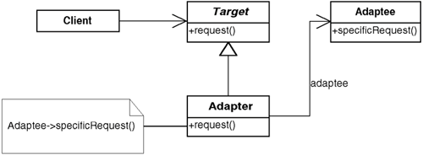
The Adapter Pattern: Key Features
Consequences | The Adapter pattern allows for preexisting objects to fit into new class structures without being limited by their interfaces.
Implementation | Contain the existing class in another class. Have the containing class match the required interface and call the methods of the contained class.

Slide 14

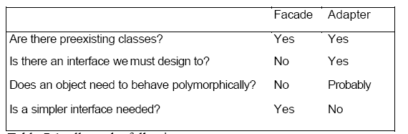
Adapter vs Facade
A Client object using another, preexisting object with the
wrong interface.

Slide 15
Strategy Pattern
Several software projects tend to ignore long-term issues such as ease of maintenance or ability to change

Slide 16
Design for Change
  "Program to an interface, not an implementation.“
  "Favor object [aggregation] over class inheritance."
  "Consider what should be variable in your design. This approach is the opposite of focusing on the cause of redesign. Instead of considering what might force a change to a design, consider what you want to be able to change without redesign. The focus here is on encapsulating the concept that varies, a theme of many design patterns."

Slide 17
E-Commerce System Case Study
We consider an order-processing system for an international e-commerce company in the United States.
This system must be able to process sales orders in many different countries.

Slide 18
System Features
The functions of SalesOrder include the following:
  Allow for filling out the order with a GUI
  Handle tax calculations
  Process the order, and print a sales receipt

Slide 19
New Requirements
New requirements for taxation rules
  Copy and paste
  Switches or ifs on a variable specifying the case we have
  Inheritance (make a derived class that does it the new way)

Slide 20
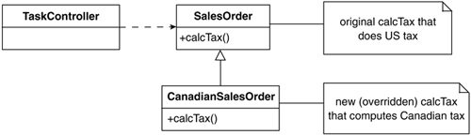

Slide 21
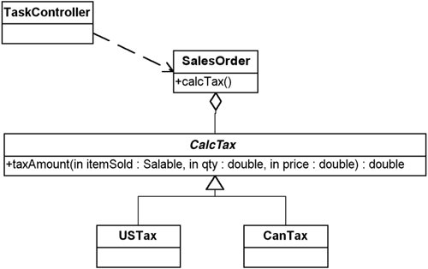
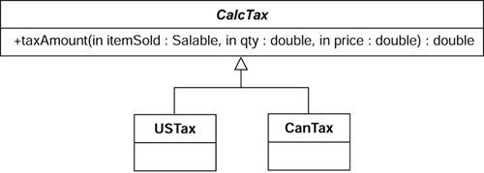
What we should do?
Based on the guiding principles:
  Find what varies and encapsulate it in a class of its own.
  Contain this class in another class (favor aggregation).

Slide 22
public class TaskController {
public void process () {
/* this code is an emulation of a processing task controller … figure out which country you are in*/
CalcTax myTax;
myTax= getTaxRulesForCountry();
SalesOrder mySO= new SalesOrder();
mySO.process(myTax);
}
private CalcTax getTaxRulesForCountry() {
/* In real life, get the tax rules based on country you are in. You may have the logic here or you may have it in a configuration file. Here, just return a USTax so this will compile. */
return new USTax();
}
}

Slide 23
public class SalesOrder {
public void process (CalcTax taxToUse) {
long itemNumber= 0;
double price= 0;
/* given the tax object to use. . calculate tax */
double tax=
taxToUse.taxAmount( itemNumber, price);
}
}

Slide 24
public abstract class CalcTax {
abstract public double taxAmount( long itemSold, double price);
}
public class CanTax extends CalcTax {
public double taxAmount( long itemSold, double price)
{
  /* in real life, figure out tax according to the rules in Canada and return it here, return 0 so this will compile*/
  return 0.0;
}
}

Slide 25
Advantages
Improves cohesion, aids flexibility
Easier to shift responsibilities

Slide 26
Strategy Pattern
Intent:
Define a family of algorithms, encapsulate each one, and make them interchangeable. Strategy lets the algorithm vary independently from clients that use it.
Motivation
The Strategy pattern is based on a few principles:
  Objects have responsibilities.
  Different, specific implementations of these responsibilities are manifested through the use of polymorphism.
  There is a need to manage several different implementations of what is, conceptually, the same algorithm.

Slide 27
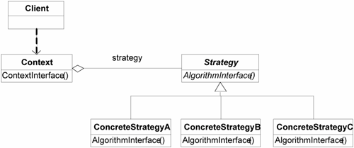
General Strategy Pattern

